Slide 1

Ride Analysis
Project

Slide 2
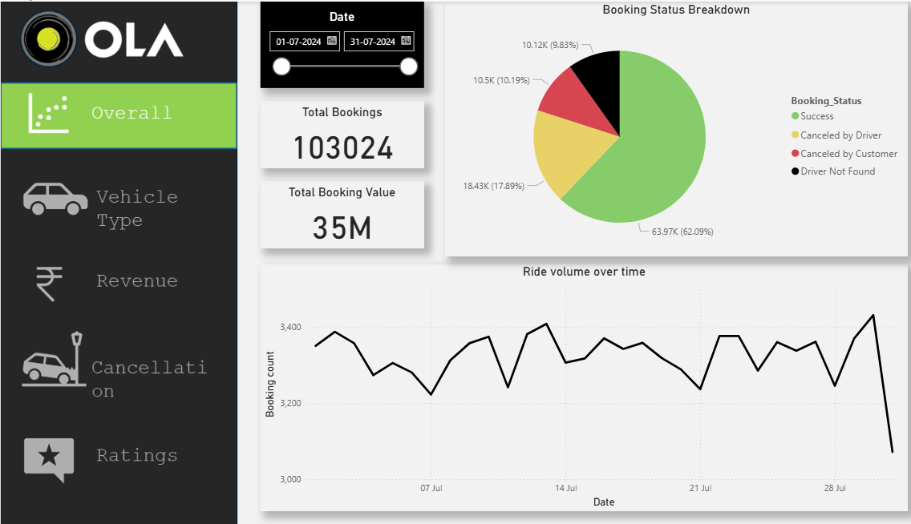
Overall

Slide 3
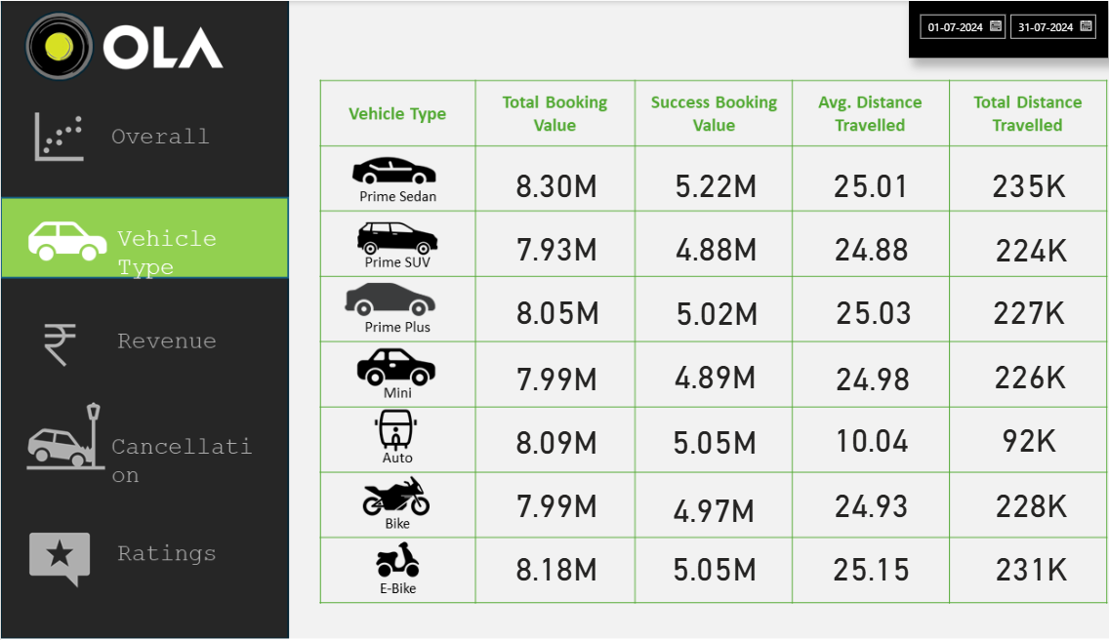
Vehicle Type

Slide 4
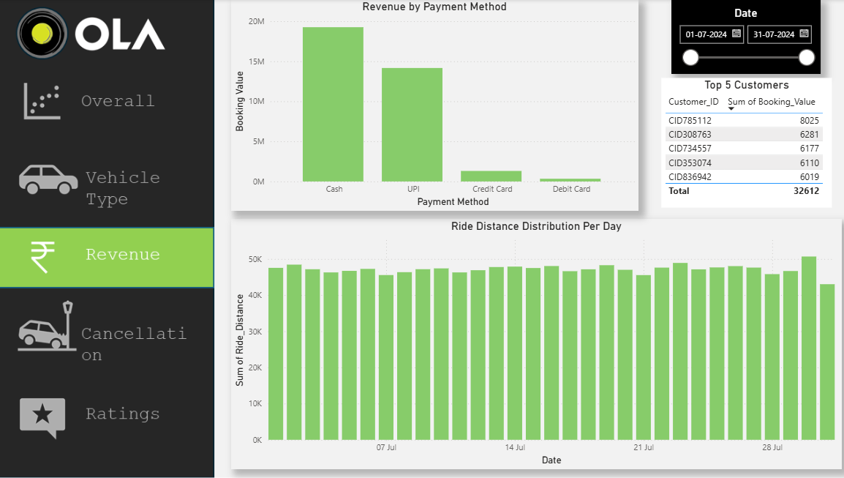
Revenue

Slide 5
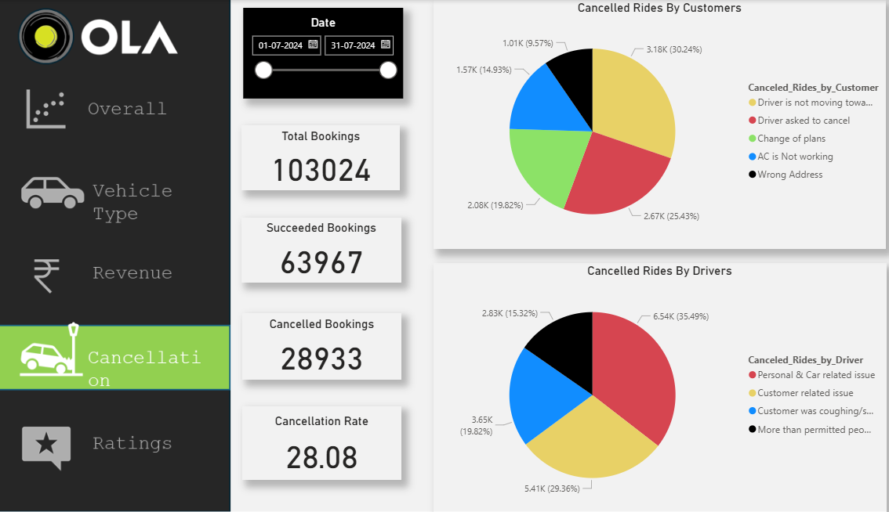
Cancellation

Slide 6
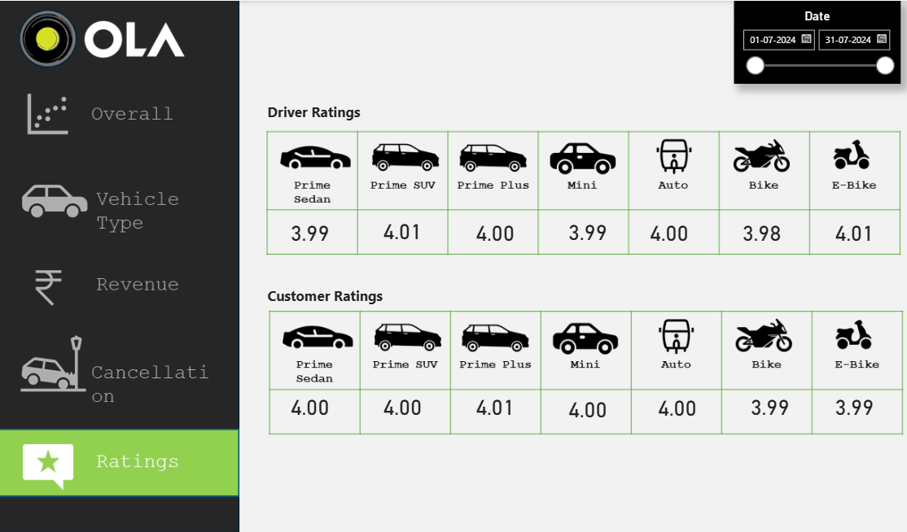
Ratings

